Slide 1
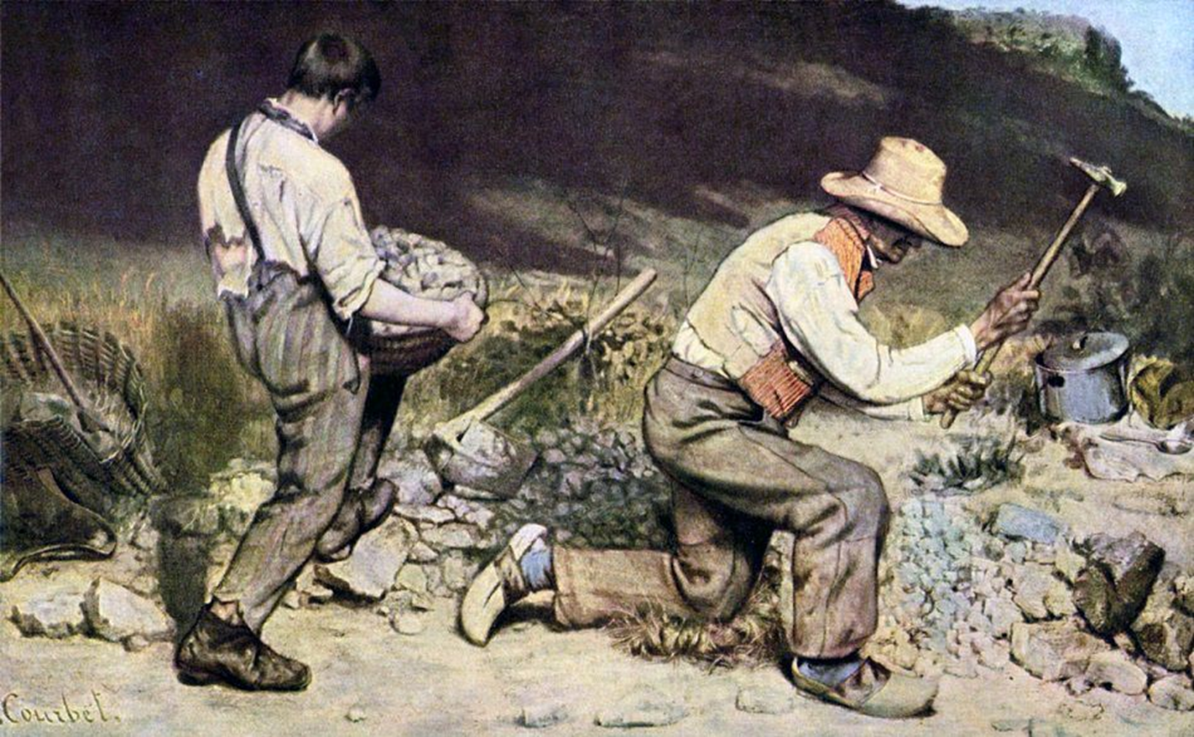
REALISM
(1840 – 1880)
History of Modern Art
BFA-III (Visual Arts)
Course Incharge: Ms. Sidra Liaqat
Institute of Design & Visual Arts, LCWU

Slide 2
Gustave Courbet
(1819 – 1877)
France

Slide 3
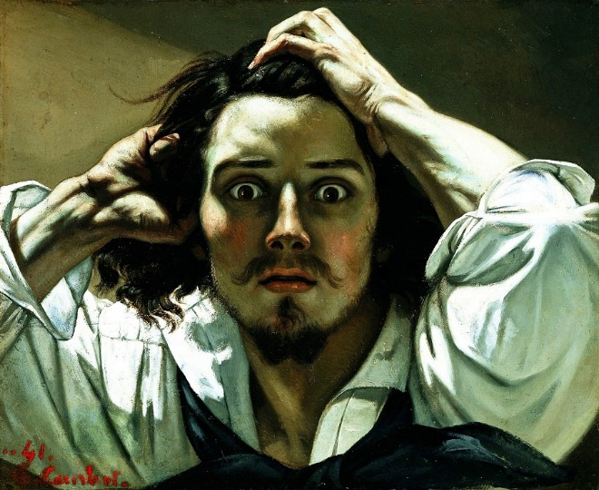
GUSTAVE COURBET
“The Desperate Man” (1843)

Slide 4
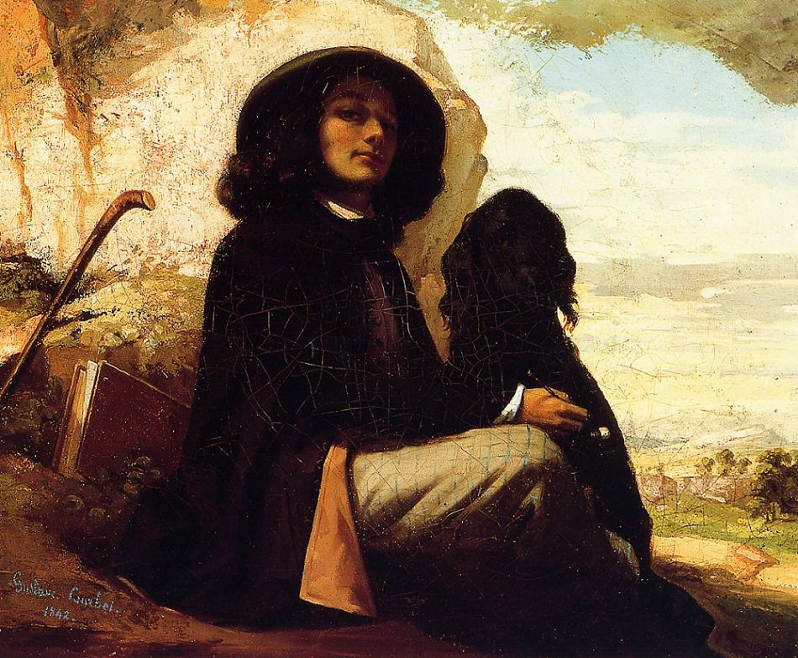
GUSTAVE COURBET
“Self Portrait with a Black Dog”
(1842)

Slide 5
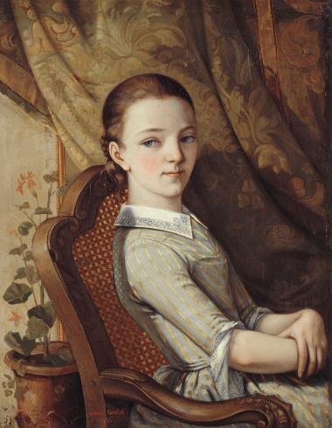
GUSTAVE COURBET
“Portrait of Juliette Courbet” (1844)

Slide 6
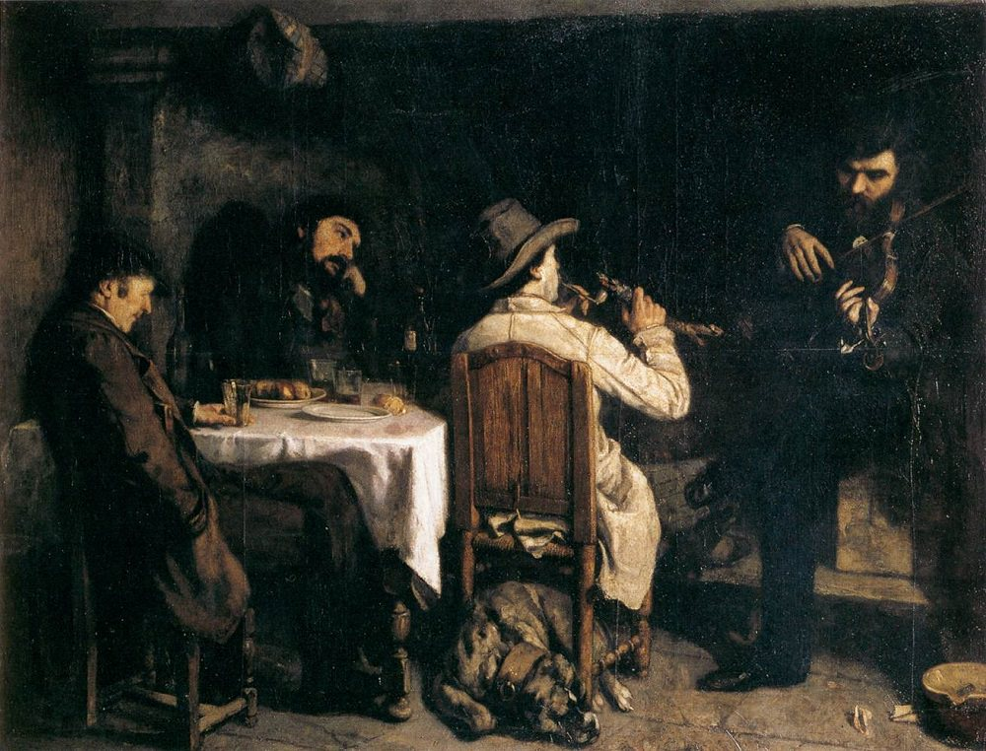
GUSTAVE COURBET
“After Dinner at Ornans”
(1848)

Slide 7
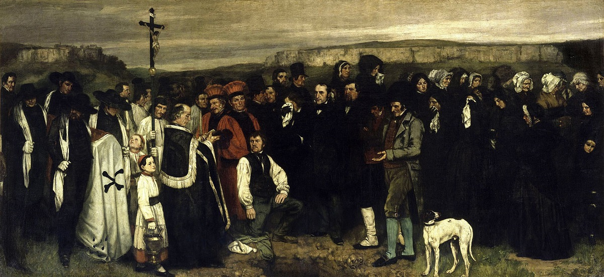
GUSTAVE COURBET “A Burial at Ornans” /
“The Funeral at Ornans” (1849)

Slide 8
GUSTAVE COURBET “The Stone Breakers” (1849)

Slide 9
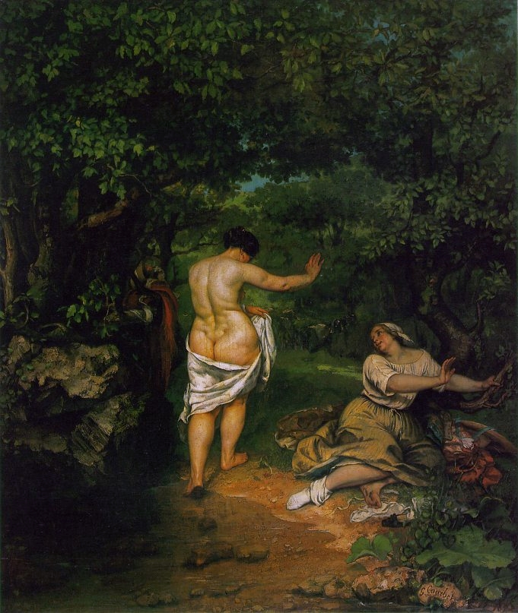
GUSTAVE COURBET
“The Bathers”
(1853)

Slide 10
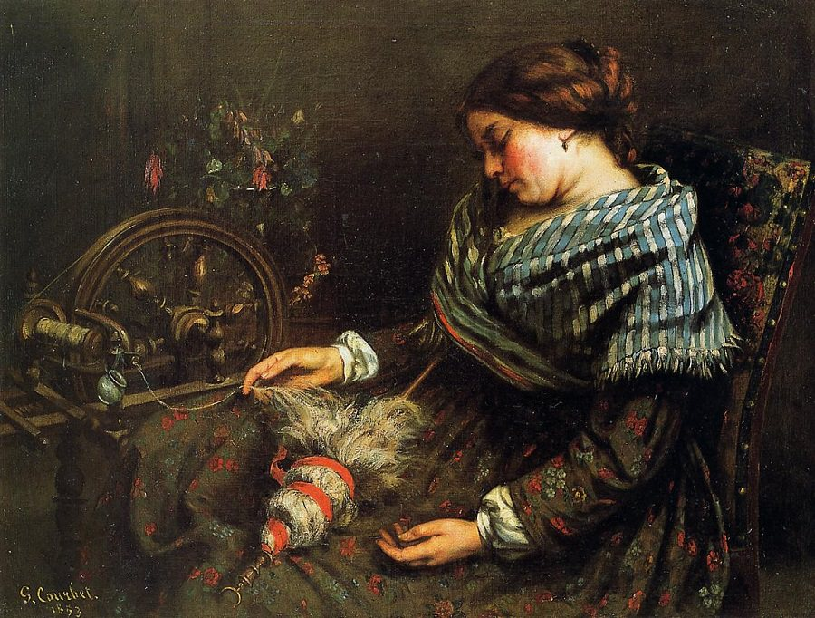
GUSTAVE COURBET
“The Sleeping Spinner” (1853)

Slide 11
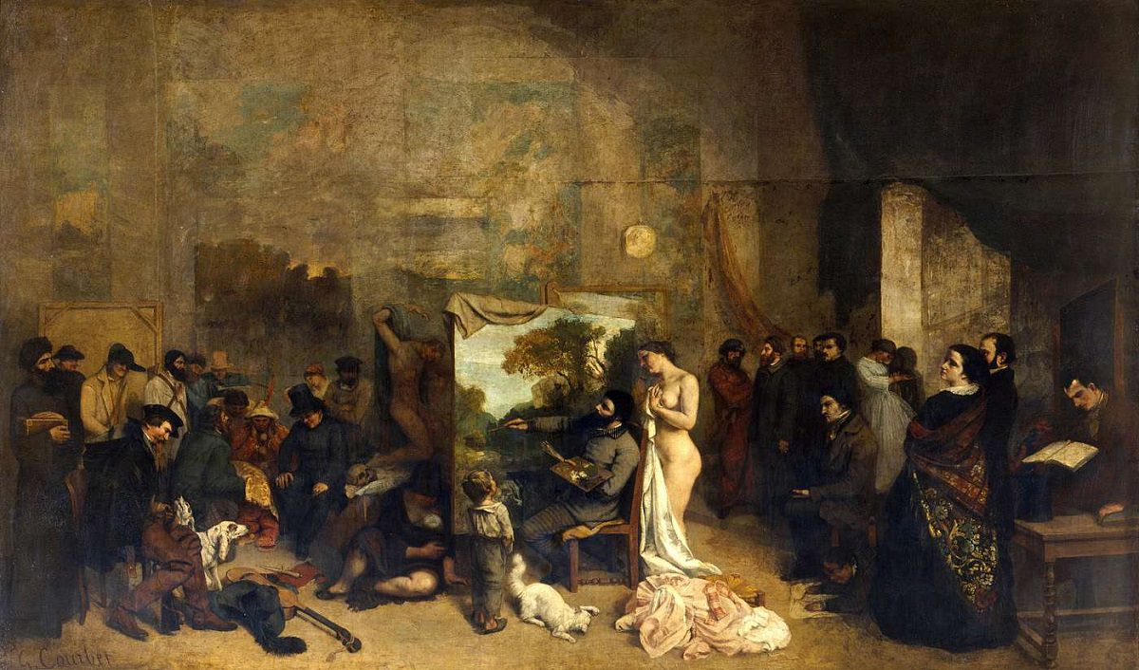
GUSTAVE COURBET “The Artist's Studio” (1855)

Slide 12
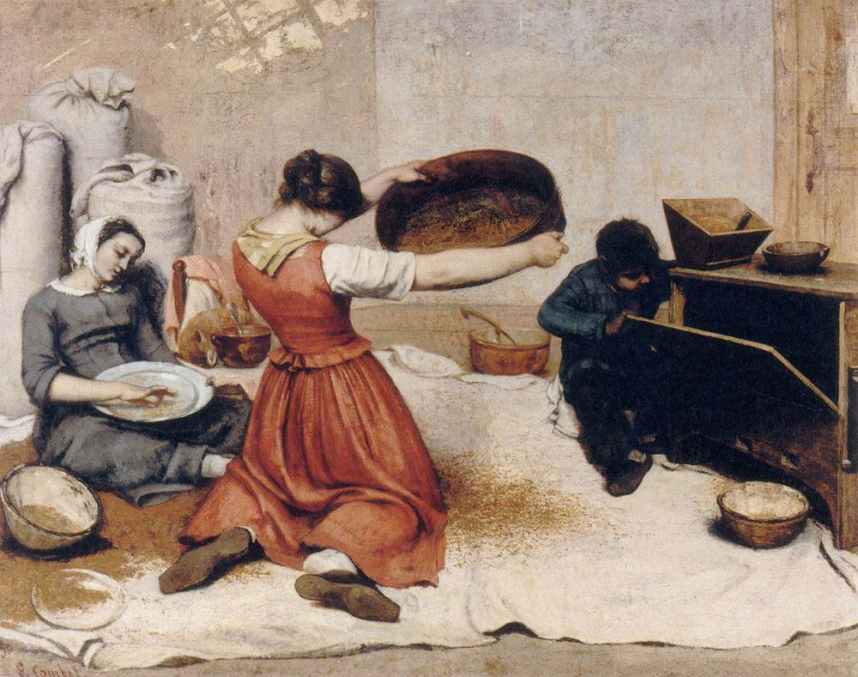
GUSTAVE COURBET
“The Grain Sifters” (1855)

Slide 13
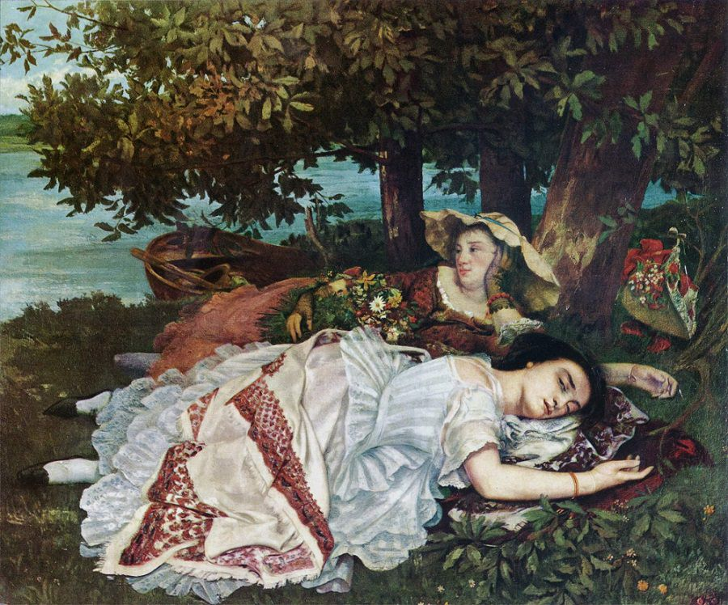
GUSTAVE COURBET
“The Young Ladies on the Banks of the Seine” (1857)

Slide 14
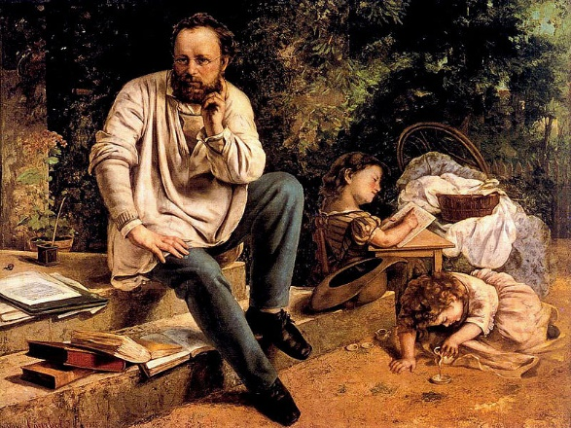
GUSTAVE COURBET
“Portrait of Proudhon”/
“Proudhon and his family”
(1865)

Slide 15
Jean-François Millet
(1814 – 1875)
France

Slide 16
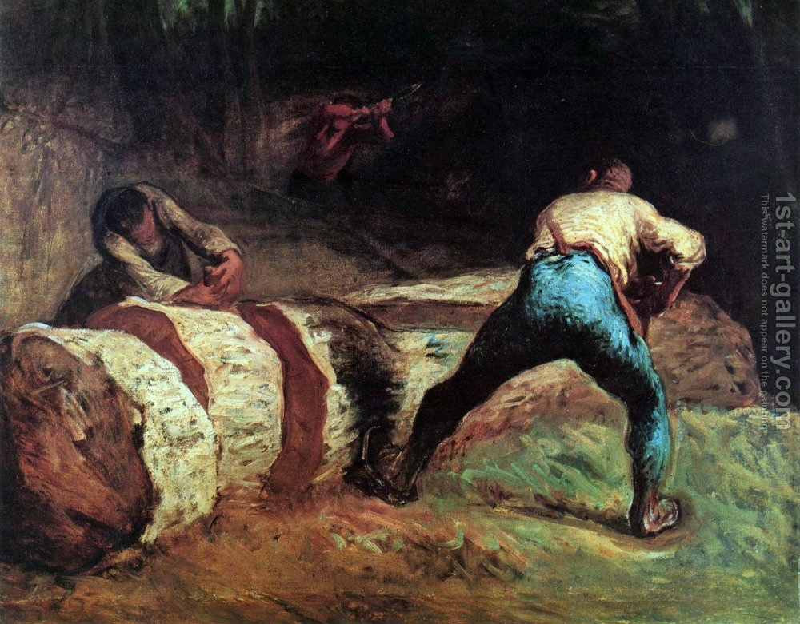
MILLET
“The Wood Sawyers” (1848)

Slide 17
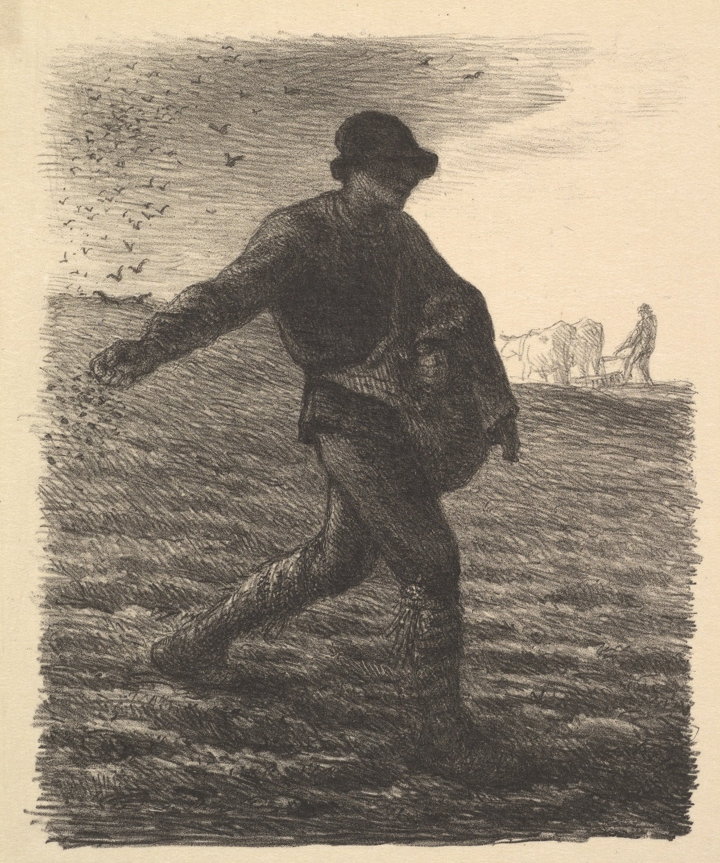
MILLET
“The Sower”
(1850s)

Slide 18
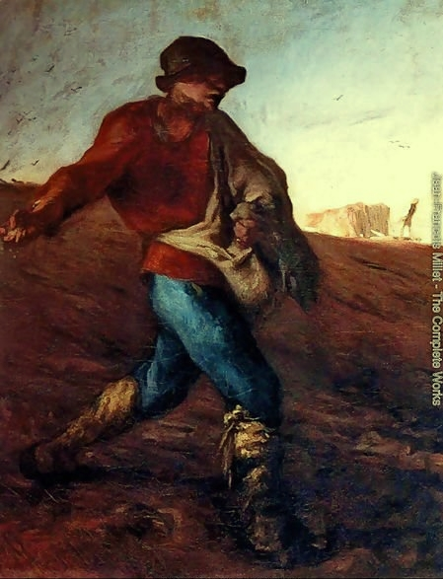
MILLET
“The Sower”
(1850)

Slide 19
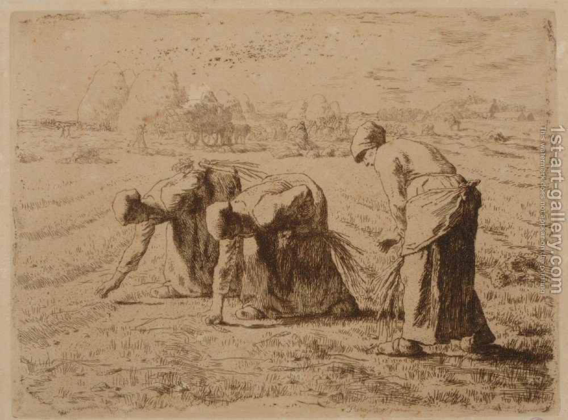
MILLET
“The Gleaners”
(1855)

Slide 20
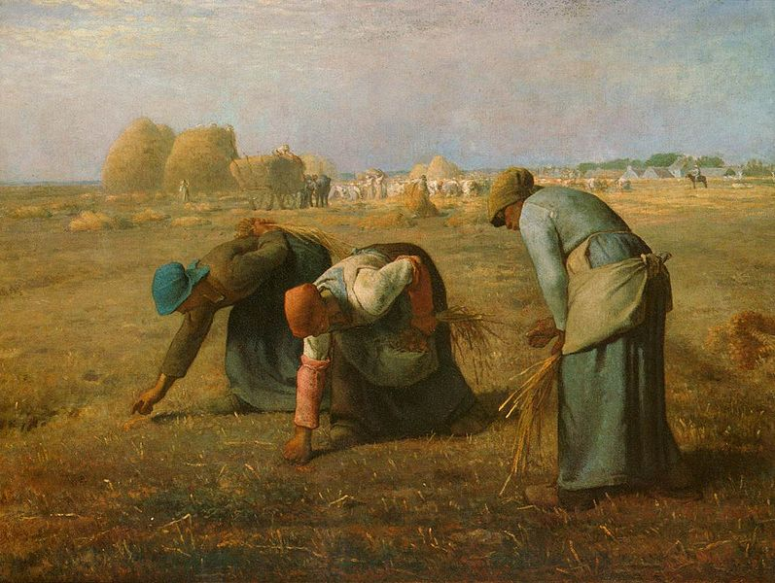
MILLET
“The Gleaners” (1857)

Slide 21
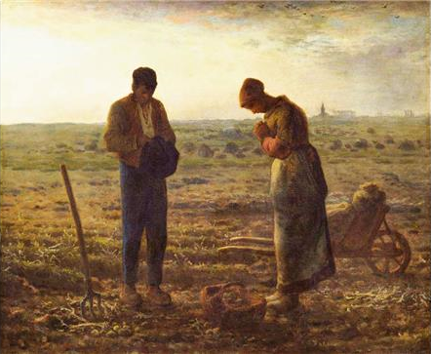
MILLET
“The Angelus”
(1859)

Slide 22
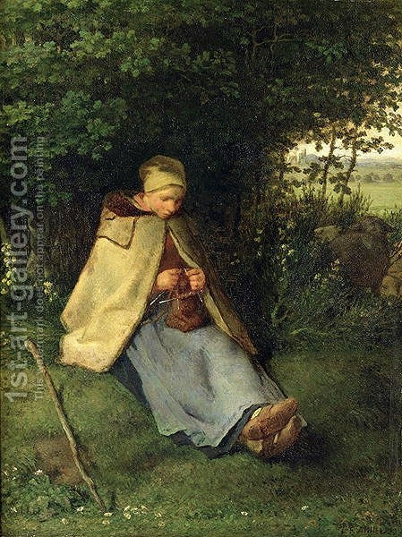
MILLET
“Knitter” / “Seated Shepherdess” (1860)

Slide 23
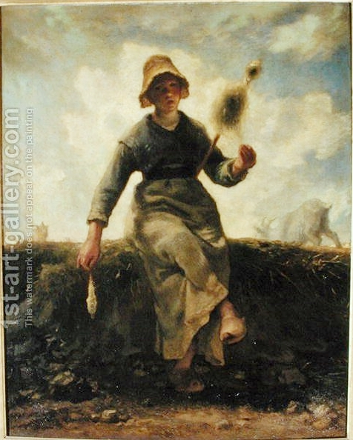
MILLET
“The Spinner”
(1869)

Slide 24
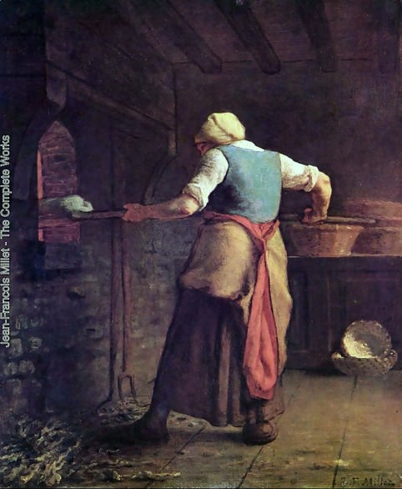
MILLET
“Woman Baking Bread”

Slide 25
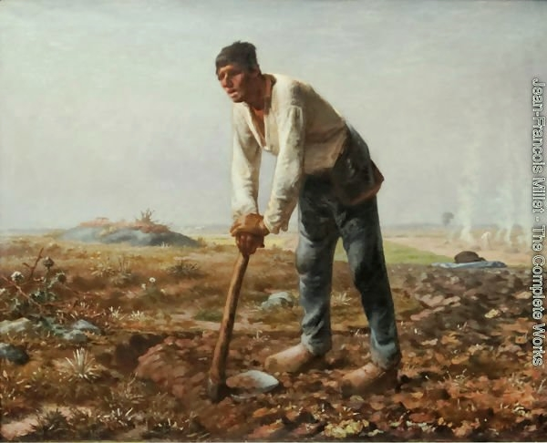
MILLET
“Man with a Hoe”

Slide 26
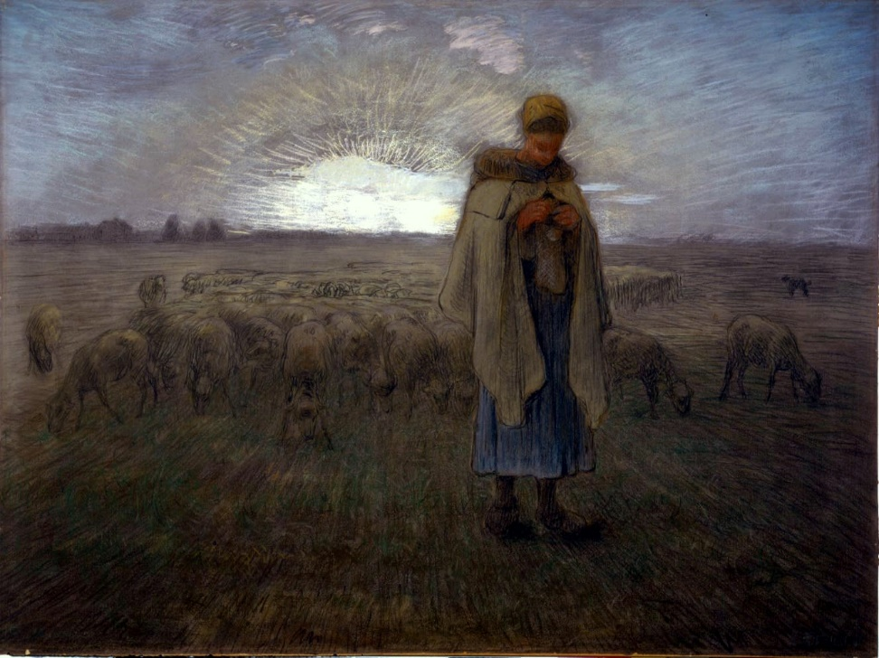
MILLET
“Young Shepherdess”

Slide 27
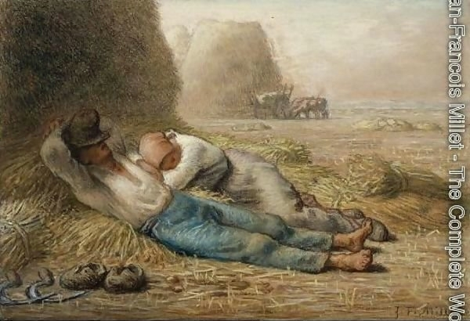
MILLET
“Noonday Rest”

Slide 28
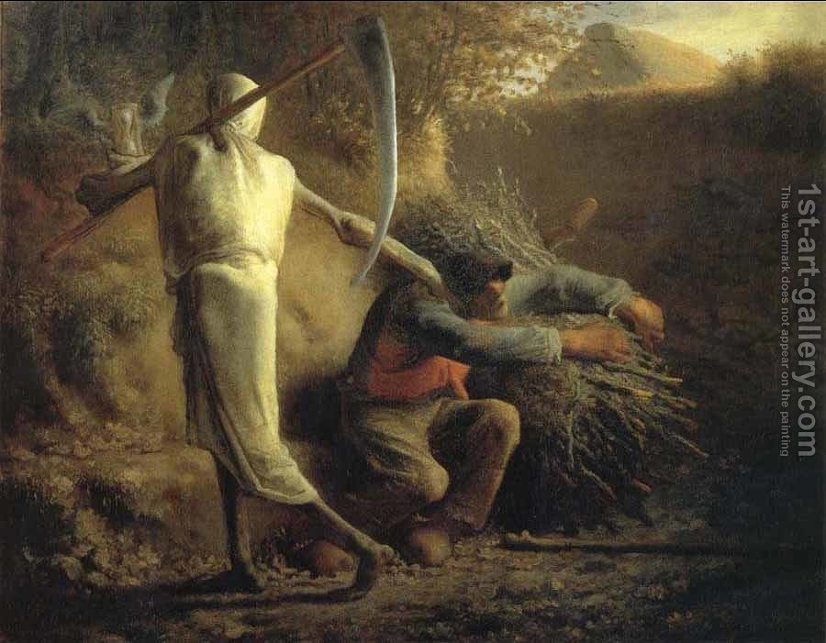
MILLET
“Death and the Woodcutter”

Slide 29
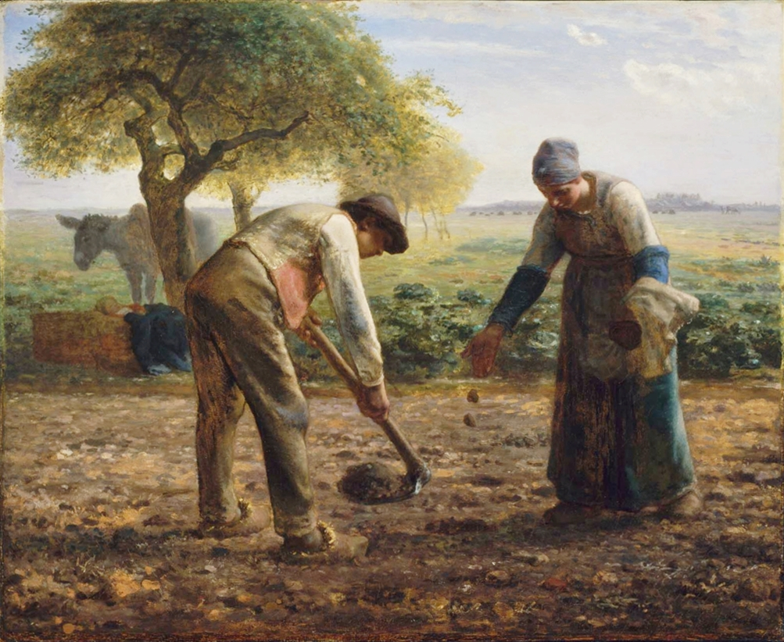
MILLET
“Potato Planters”

Slide 30
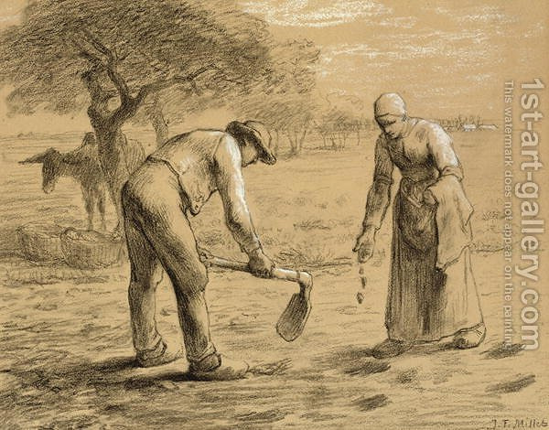
MILLET
“Peasants Planting Potatoes”

Slide 31
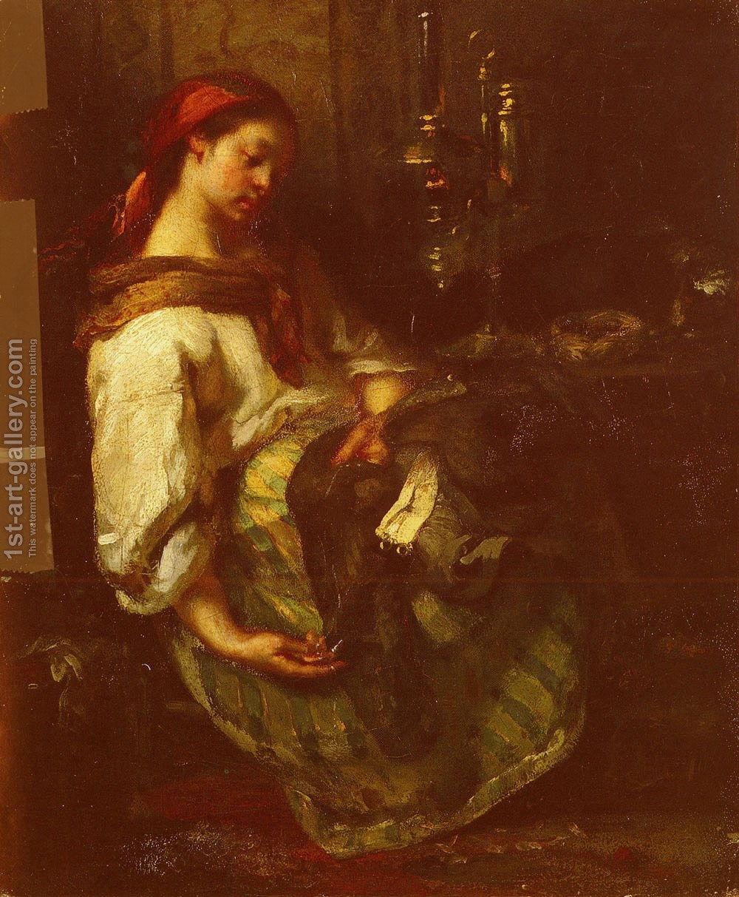
MILLET
“Sleeping Sewer”

Slide 32
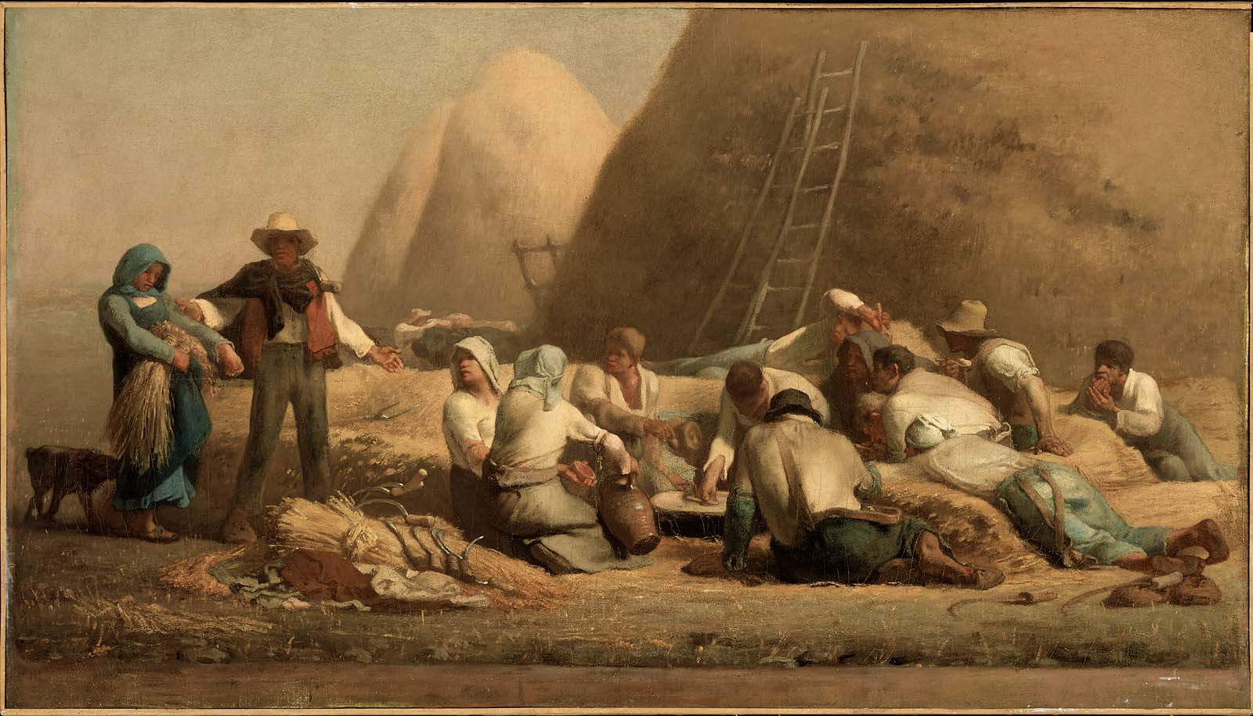
MILLET “Harvesters Resting”

Slide 33
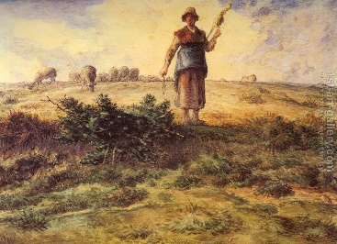
MILLET
“A Shepherdess and her Folk”

Slide 34
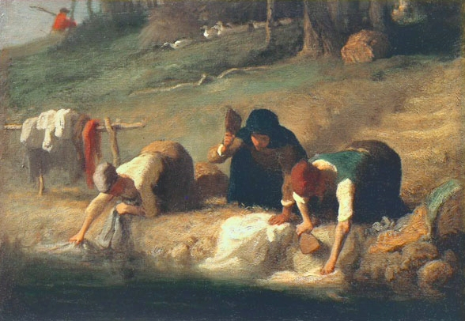
MILLET
“The Washer Women”

Slide 35
Honoré Daumier
(1808 – 1879)
France

Slide 36
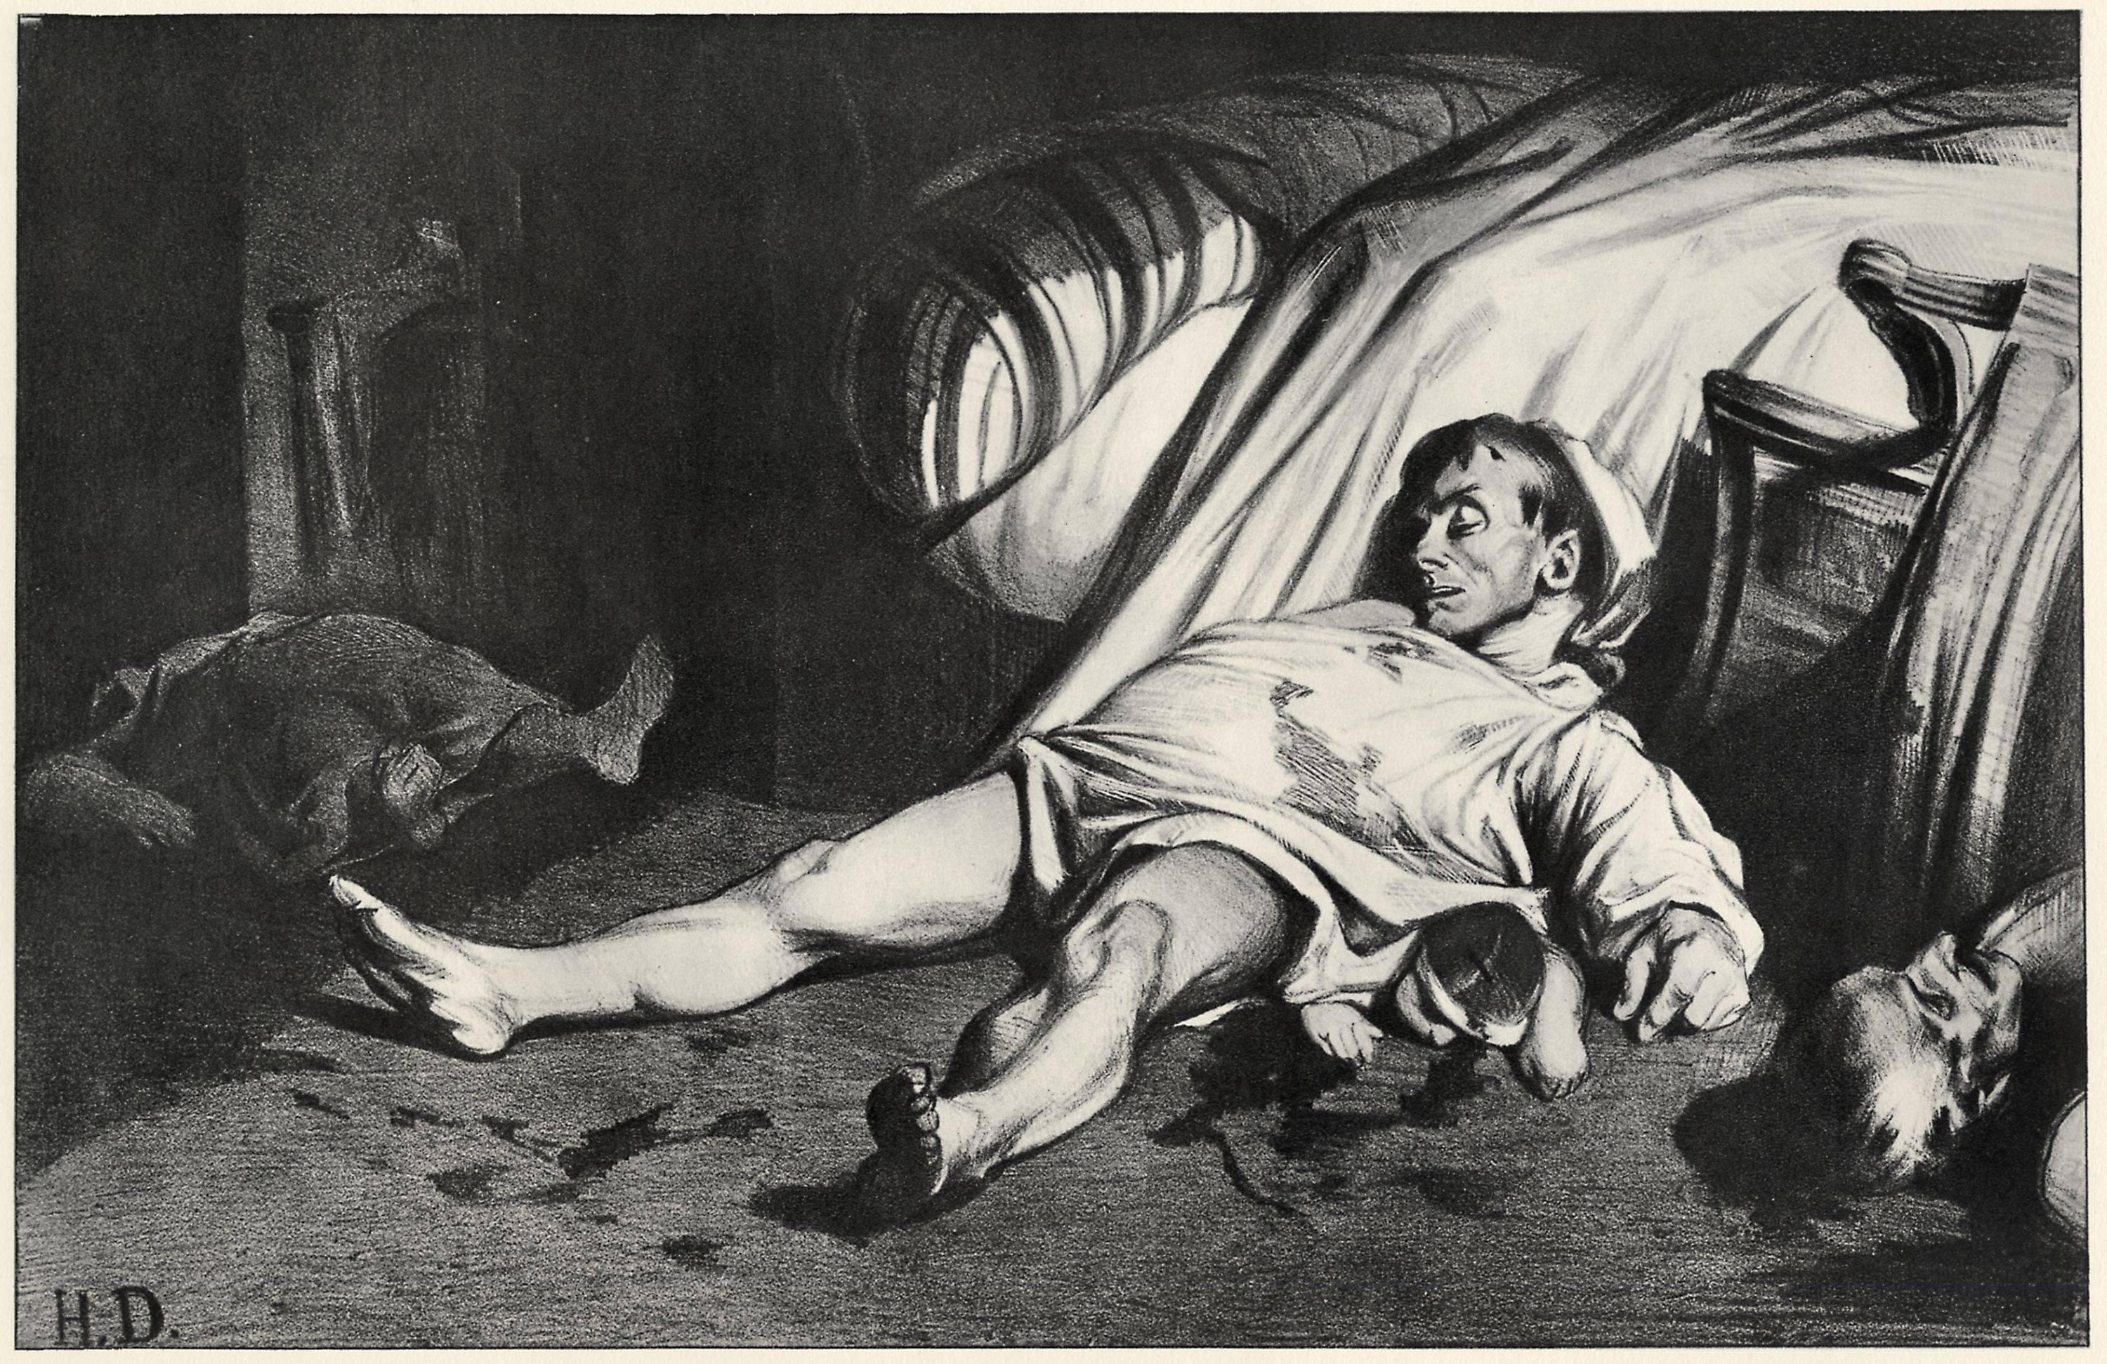
HONORÉ DAUMIER “Rue Transnonain” (1834)

Slide 37
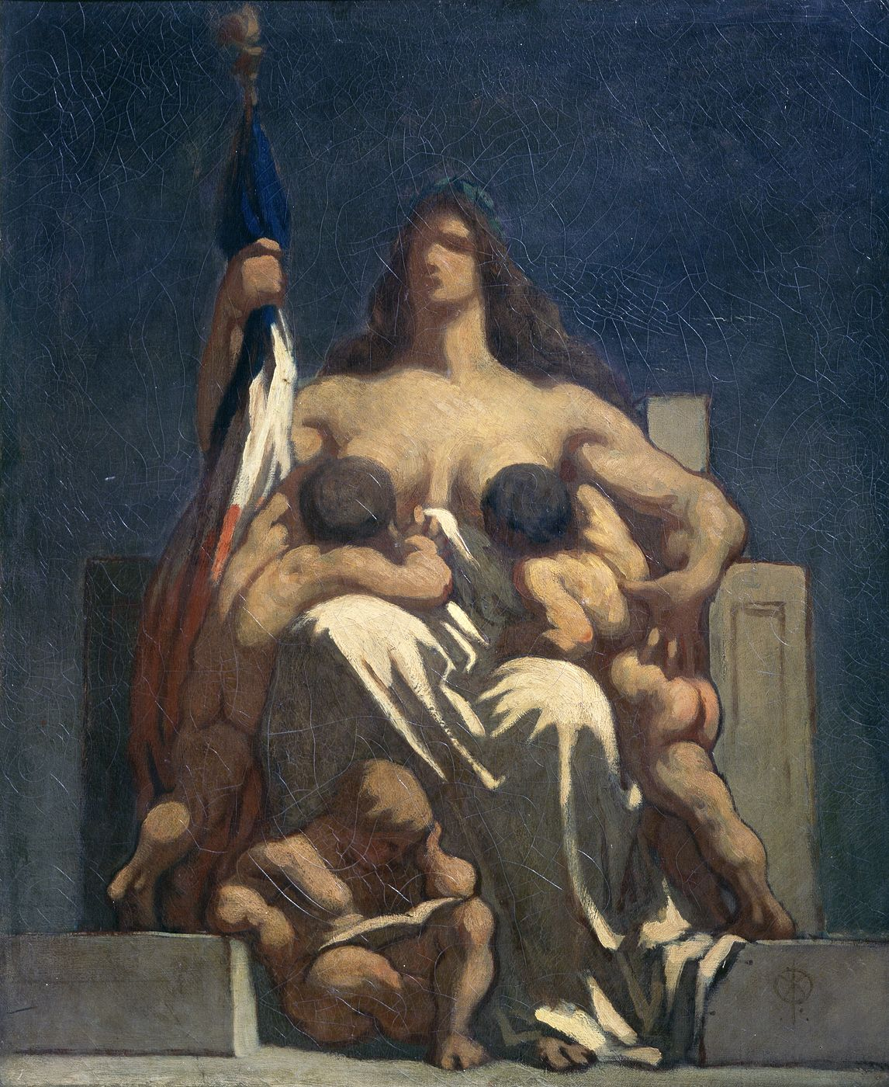
HONORÉ DAUMIER
“La République”
(1848)

Slide 38
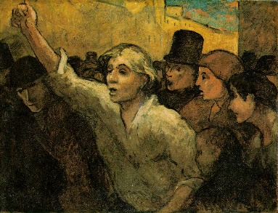
HONORÉ DAUMIER
“The Uprising”
(1848/49)

Slide 39
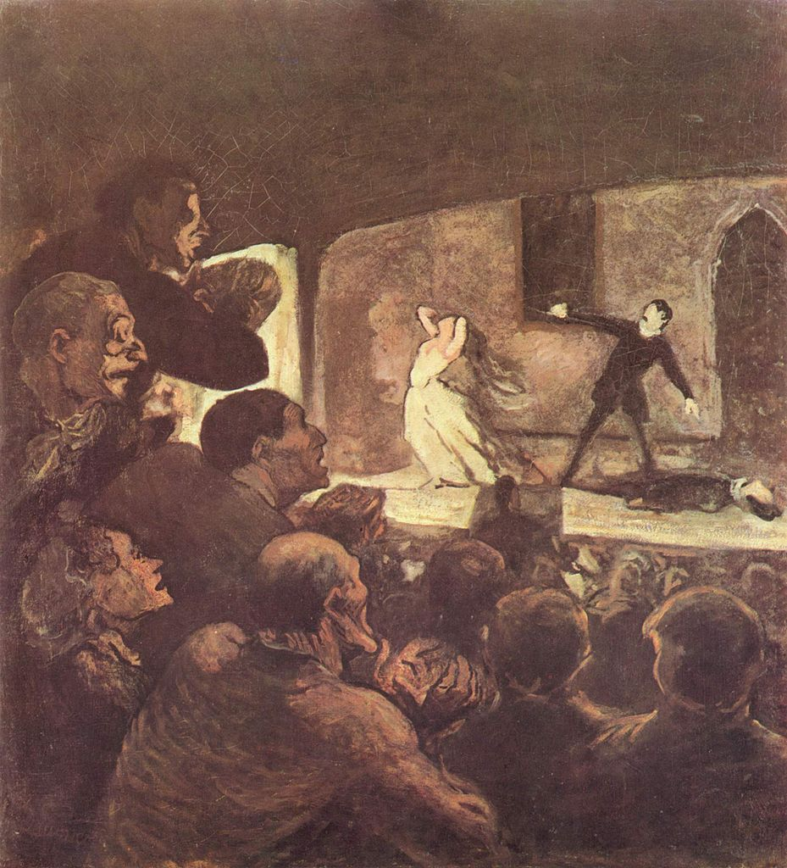
HONORÉ DAUMIER
“The Melodrama”
(1856-63)

Slide 40
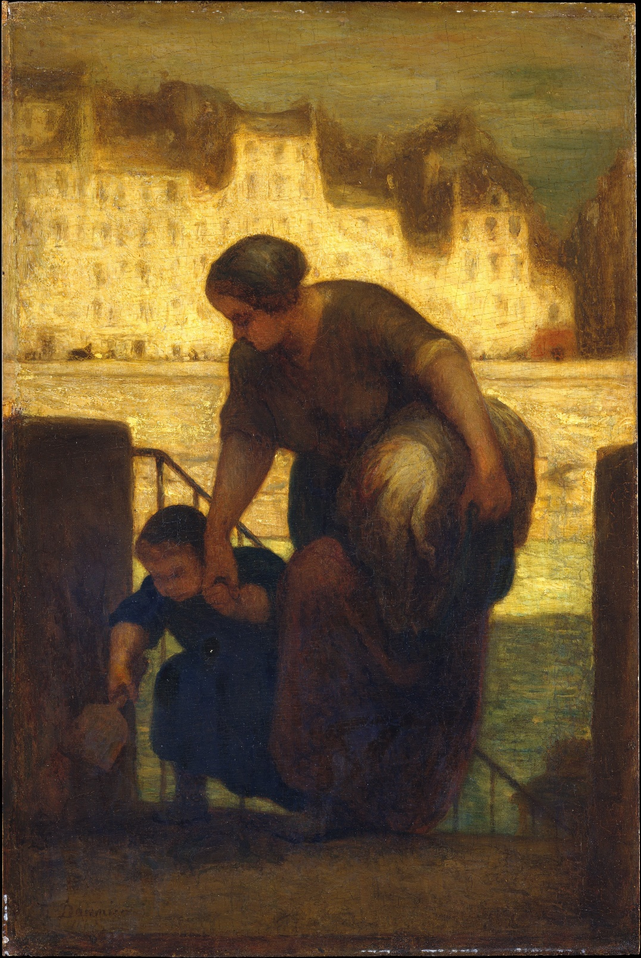
HONORÉ DAUMIER
“The Washer Woman”
(1863/64)

Slide 41
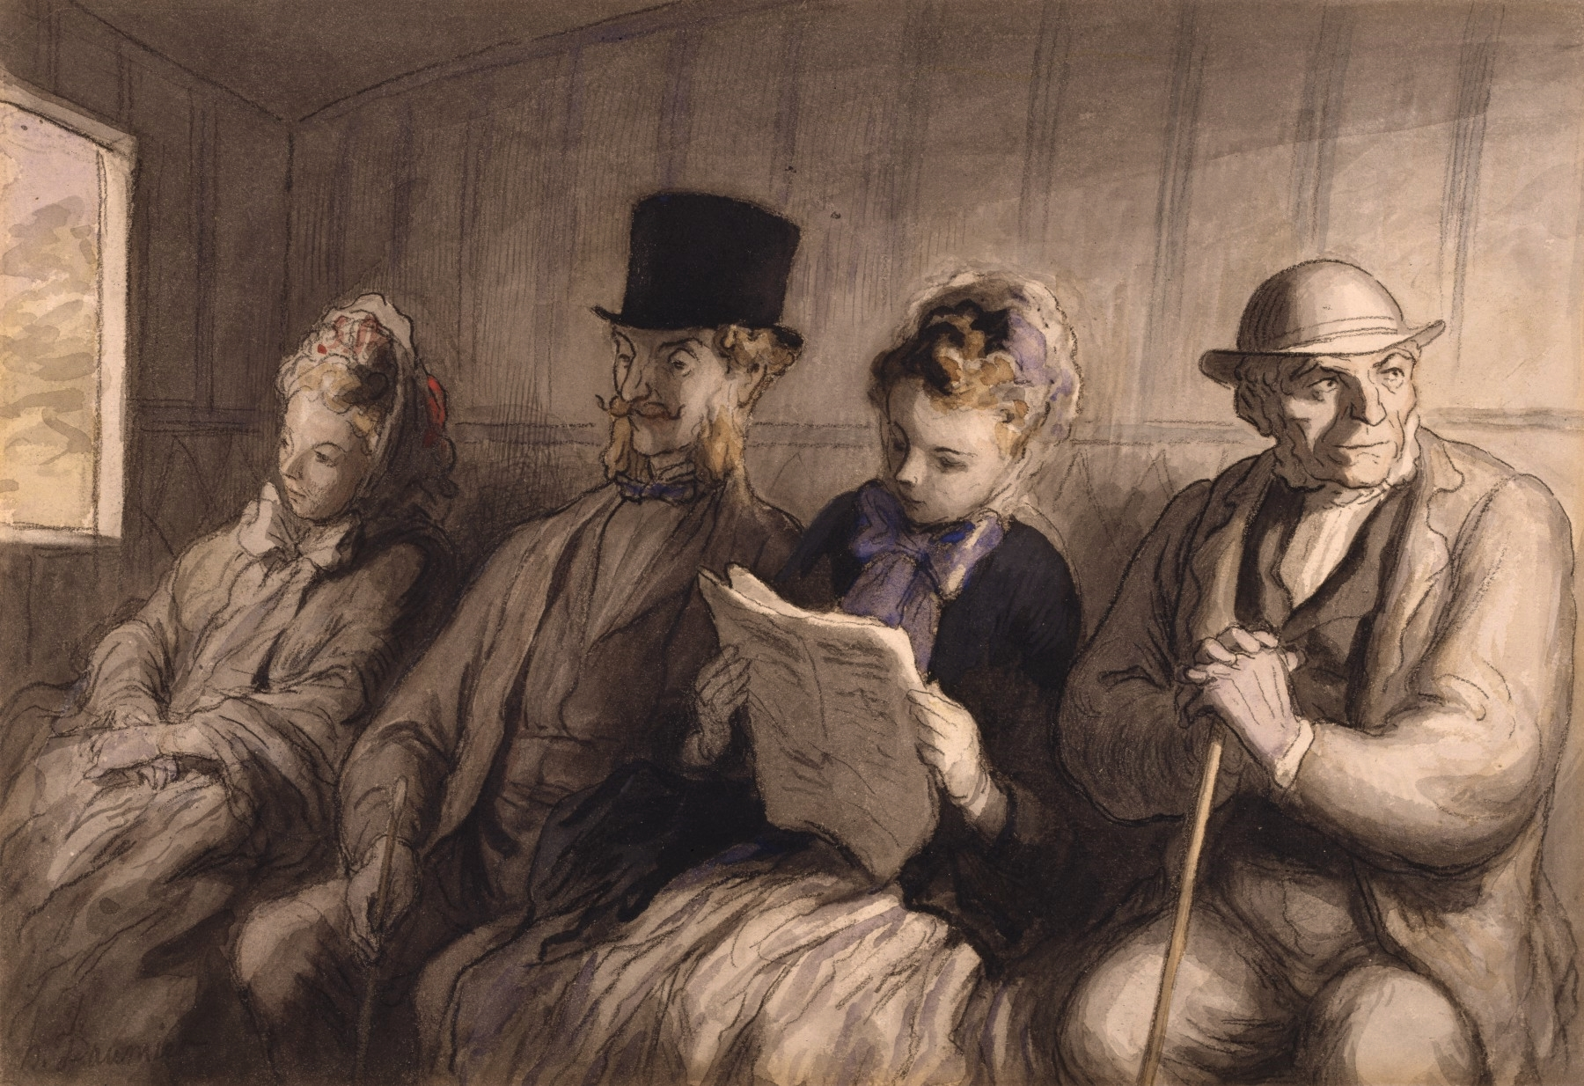
HONORÉ DAUMIER
“The First Class Railway Carriage” (1864)

Slide 42
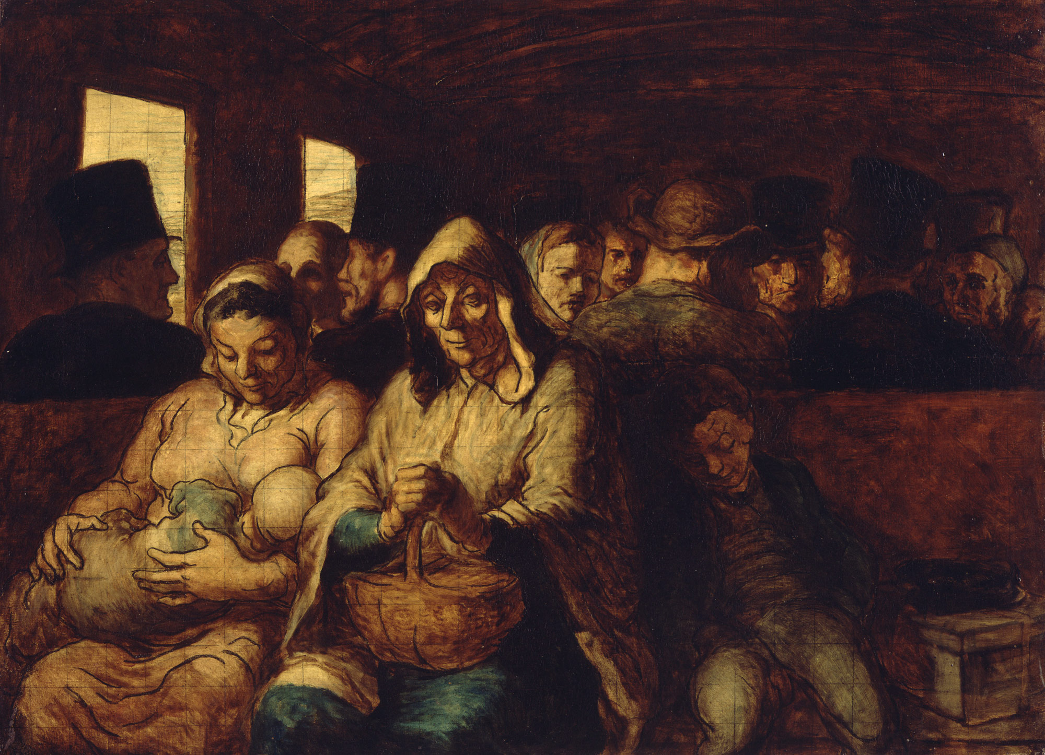
HONORÉ DAUMIER
“The Third Class Railway Carriage” (1864-65)

